Slide 1

Investigating Audible best sellers
Stefan Hainzer, August 2017

Slide 2
Audible Best Sellers
Audible.com is an amazon company which is specialized in audio books.
They provide a best seller list on their homepage.
The goal was to scrap the best sellers and to analyse them for some trends.

Slide 3
Web Scraping
Modern websites often use advanced software frameworks to improve the user experience.
That includes responsive design, client side code (JavaScript), dynamic content loading, asynchrony requests, etc.
Static requests for scraping are limited due to dynamic site behaviour.
Selenium provides a solution but has slow performance.
To overcome this drawback a parallel scraping was developed, using one web browser per processor core.
The scraper uses the Python package “Parallel Pyhton” http://www.parallelpython.com/
One Master gets the overview list from www.audible.com/adblbestsellers and delegates the book data collection to the slaves.

Slide 4
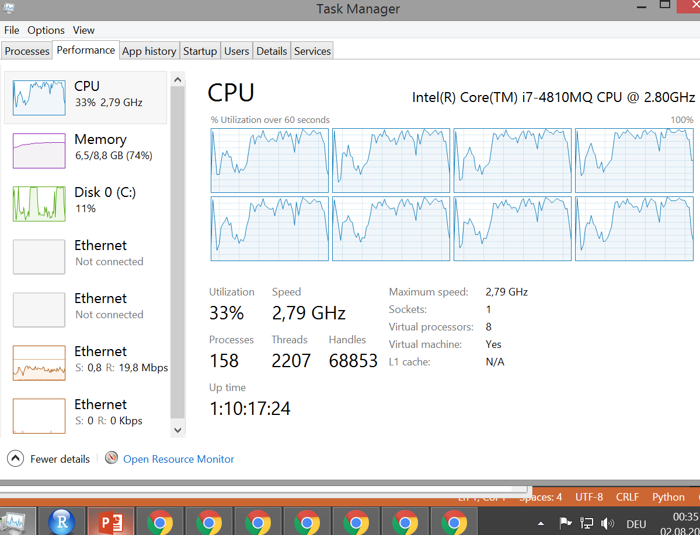
Web Scraping

Slide 5
Web Scraping
To evaluate the performance five serial and parallel scraping runs were performed.
The best seller list contains 60 books.
The mean serial duration was: 178 seconds
The mean parallel duration was: 71 seconds.
One master and seven slaves have been used.
The Parallel Python package also support slaves on remote machines.

Slide 6
Data Analysis
Change to jupyter notebook.

